Slide 1


CIS300 Test Review
Dale McIntosh
Spring 2009
© 2009 Dale McIntosh. All Rights Reserved.

Slide 2

Microsoft® Excel ®
Logical Functions
Mathematical Functions

Slide 3
Microsoft® Excel ® Logical Functions
AND
=AND(logical1, [logical2], ...)
OR
=OR(logical1, [logical2], ...)
NOT
=NOT(logical)
IF
=IF(logical_test, [value_if_true], [value_if_false])
ISNUMBER
=ISNUMBER(value)
ISBLANK
=ISBLANK(value)

Slide 4
The AND function
Syntax:
=AND(logical1, [logical2], ...)
Arguments:
logical1 Required
The first condition that you want to test that can evaluate to either TRUE or FALSE.
logical2, ... Optional
Additional conditions that you want to test that can evaluate to either TRUE or FALSE, up to a maximum of 255 conditions.

Slide 5
The AND function
Description:
Returns FALSE if one or more arguments is FALSE
Otherwise, all arguments must evaluate TRUE
Remarks:
Arguments must evaluate to logical values
Arguments must be arrays or references that contain logical values
Text and empty cells are ignored in arrays or references
Errors:
#VALUE – If no logical values exist in a specified range

Slide 6
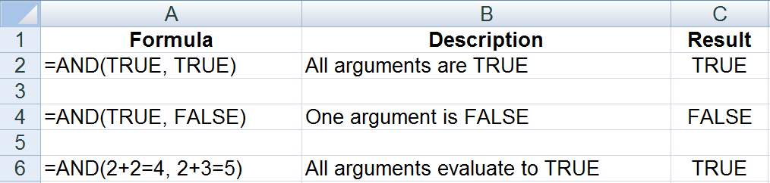
The AND function – EXAMPLE 1
✓
✓
✓
✗
✓
✓

Slide 7
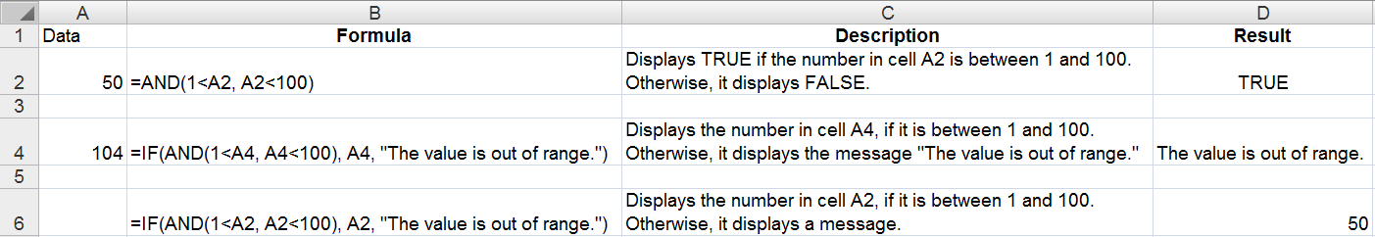
The AND function – EXAMPLE 2
✓
✓
✓
✗
✓
✓

Slide 8
The OR function
Syntax:
=OR(logical1, [logical2], ...)
Arguments:
logical1 Required
The first condition that you want to test that can evaluate to either TRUE or FALSE.
logical2, ... Optional
Additional conditions that you want to test that can evaluate to either TRUE or FALSE, up to a maximum of 255 conditions.

Slide 9
The OR function
Description:
Returns TRUE if one or more arguments is TRUE
Otherwise, all arguments must evaluate FALSE
Remarks:
Arguments must evaluate to logical values
Arguments must be arrays or references that contain logical values
Text and empty cells are ignored in arrays or references
Errors:
#VALUE – If no logical values exist in a specified range

Slide 10
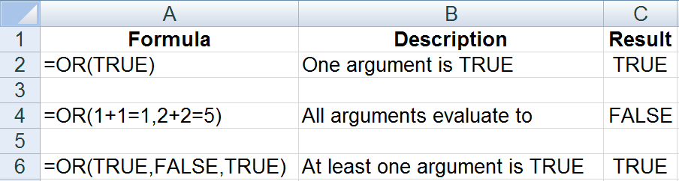
The OR function
✓
✗
✗
✓
✗
✓

Slide 11
The NOT function
Syntax:
=NOT(logical)
Arguments:
logical Required
A value or expression that can be evaluated to TRUE or FALSE.

Slide 12
The NOT function
Description:
Reverses the value of its argument.
Remarks:
If logical is FALSE, NOT returns TRUE
if logical is TRUE, NOT returns FALSE
Errors:
None

Slide 13
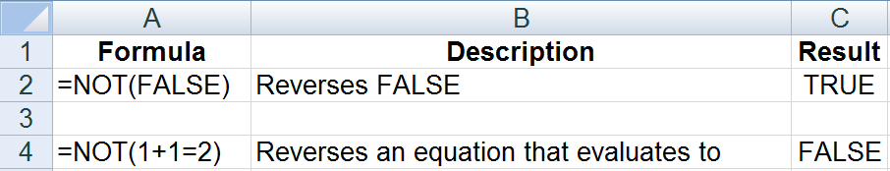
The NOT function

Slide 14
The IF function
Syntax:
=IF(logical_test, [value_if_true], [value_if_false])
Arguments:
logical_test Required
Any value or expression that can be evaluated to TRUE or FALSE.
value_if_true Optional
The value that you want to be returned if the logical_test argument evaluates to TRUE.
If logical_test evaluates to TRUE and the value_if_true argument is omitted (that is, there is only a comma following the logical_test argument), the IF function returns 0 (zero).
To display the word TRUE, use the logical value TRUE for the value_if_true argument.

Slide 15
The IF function
Syntax:
=IF(logical_test, [value_if_true], [value_if_false])
Arguments:
value_if_false Optional
The value that you want to be returned if the logical_test argument evaluates to FALSE.
If logical_test evaluates to FALSE and the value_if_false argument is omitted, (that is, there is no comma following the value_if_true argument), the IF function returns the logical value FALSE.
If logical_test evaluates to FALSE and the value of the value_if_false argument is omitted (that is, in the IF function, there is a comma following the value_if_true argument), the IF function returns the value 0 (zero).

Slide 16
The IF function
Description:
The IF function returns one value if a condition you specify evaluates to TRUE, and another value if that condition evaluates to FALSE.
Remarks:
Up to 7 IF functions can be nested as value_if_true and value_if_false arguments to construct more elaborate tests. (2003)
Up to 64 IF functions can be nested as value_if_true and value_if_false arguments to construct more elaborate tests. (2007)
If any of the arguments to IF are arrays, every element of the array is evaluated when the IF statement is carried out.
Errors:
None

Slide 17
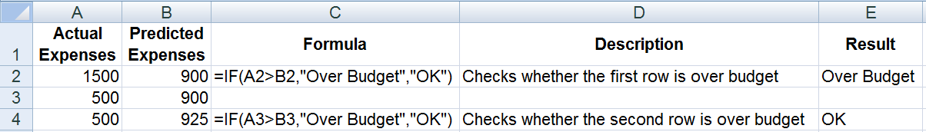
The IF function
✓
✗
value_if_true
[value_if_false]

Slide 18
The ISNUMBER function
Syntax:
=ISNUMBER(value)
Arguments:
value Required
The cell or a name that refers to the cell you want to test. Value can refer to a cell, a formula, or a name that refers to a cell, formula, or value.

Slide 19
The ISNUMBER function
Description:
Returns the logical value TRUE if the value argument is a reference to a number
Otherwise, all arguments must evaluate FALSE
Remarks:
Arguments must evaluate to logical values
Arguments must be arrays or references that contain logical values
Text values are not converted to numbers, ex. ISNUMBER(“18”) evaluates to FALSE

Slide 20
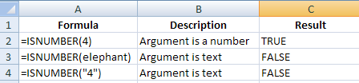
The ISNUMBER function – EXAMPLE
✓
✗
✗

Slide 21
The ISBLANK function
Syntax:
=ISBLANK(value)
Arguments:
value Required
The cell or a name that refers to the cell you want to test.

Slide 22
The ISBLANK function
Description:
Returns the logical value TRUE if the value argument is a reference to an empty cell
Otherwise, all arguments must evaluate FALSE
Remarks:
Arguments must evaluate to logical values
Arguments must be arrays or references that contain logical values

Slide 23
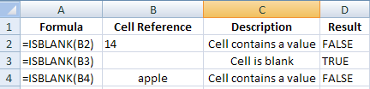
The ISBLANK function – EXAMPLE
✗
✓
✗

Slide 24
Microsoft® Excel® Mathematical Functions
SUM
=SUM(number1,[number2], ...)

Slide 25
The SUM function
Syntax:
=SUM(number1, [number2], [number3], [number4], ...)
Arguments:
number1 Required
The first item that you want to add.
number2, number3, number4, ... Optional
The remaining items that you want to add, up to a total of 255 items.

Slide 26
The SUM function
Description:
Adds all the numbers that you specify as arguments.
Remarks:
Each argument can be a range, a cell reference, an array, a constant, a formula, or the result from another function.
If an argument is an array or reference, only numbers in that array or reference are counted. Empty cells, logical values, or text in the array or reference are ignored.
Errors:
If any arguments are error values, or if any arguments are text that cannot be translated into numbers, Excel displays an error.

Slide 27
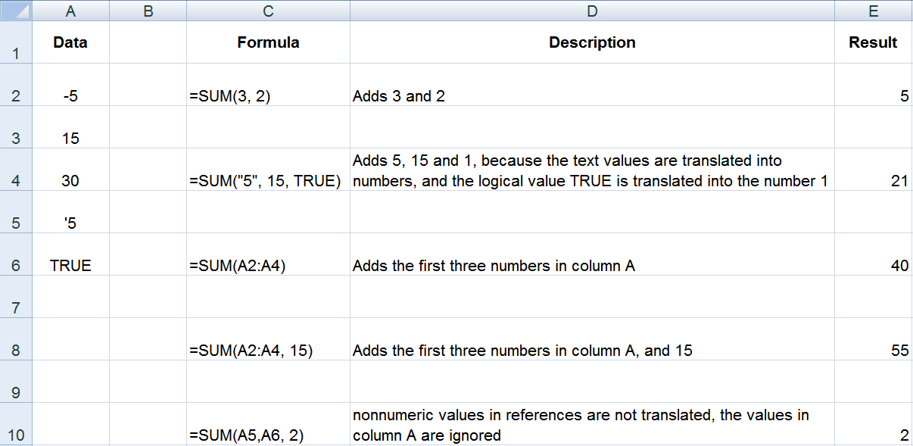
The SUM function

Slide 28
Microsoft® Excel® Statistical Functions
AVERAGE
=AVERAGE(number1, [number2],...)
AVERAGEIF
=AVERAGEIF(range,criteria,[average_range])
COUNT
=COUNT(value1, [value2],...)
COUNTA
=COUNTA(value1, [value2],...)
MAX
=MAX(number1,[number2],...)
MIN
=MIN(number1,[number2],...)

Slide 29
The AVERAGE function
Syntax:
=AVERAGE(number1, [number2],...)
Arguments:
number1 Required
The first number, cell reference, or range for which you want the average.
number2, ... Optional
Additional numbers, cell references or ranges for which you want the average, up to a maximum of 255.

Slide 30
The AVERAGE function
Description:
Returns the average (arithmetic mean) of the arguments.
Remarks:
Arguments can either be numbers or names, ranges, or cell references that contain numbers.
Logical values and text representations of numbers that you type directly into the list of arguments are counted.
If a range or cell reference argument contains text, logical values, or empty cells, those values are ignored; however, cells with the value zero are included.
Errors:
Arguments that are error values or text that cannot be translated into numbers cause errors.

Slide 31
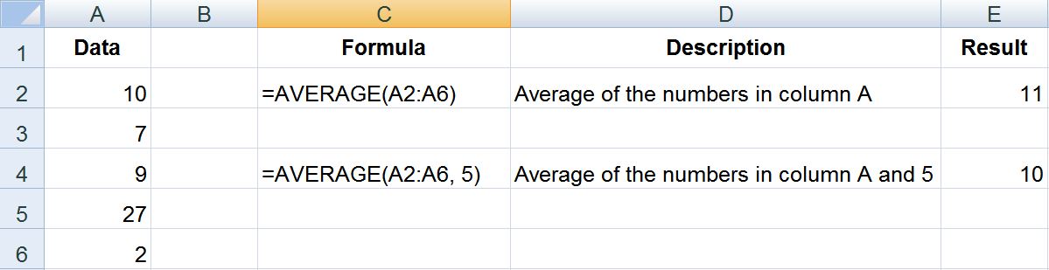
The AVERAGE function

Slide 32
The COUNT function
Syntax:
=COUNT(value1, [value2],...)
Arguments:
value1 Required
The first item, cell reference, or range within which you want to count numbers.
value2, ... Optional
Up to 255 additional items, cell references, or ranges within which you want to count numbers.

Slide 33
The COUNT function
Description:
Counts the number of cells that contain numbers, and counts numbers within the list of arguments.
Remarks:
Arguments that are numbers, dates, or a text representation of numbers (for example, a number enclosed in quotation marks, such as "1") are counted.
Logical values and text representations of numbers that you type directly into the list of arguments are counted.
Arguments that are error values or text that cannot be translated into numbers are not counted.
If an argument is an array or reference, only numbers in that array or reference are counted. Empty cells, logical values, text, or error values in the array or reference are not counted.
Errors:
None

Slide 34
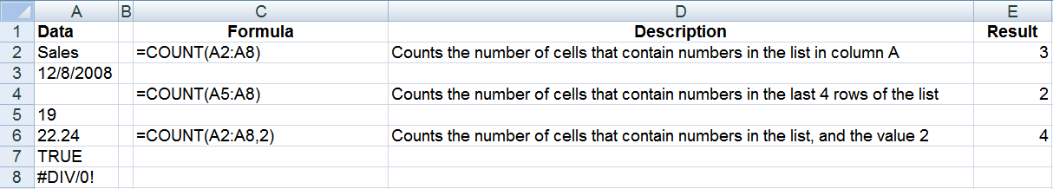
The COUNT function

Slide 35
The MAX function
Syntax:
=MAX(number1,[number2],...)
Arguments:
number1, number2, ... Required
1 to 255 numbers for which you want to find the maximum value.

Slide 36
The MAX function
Description:
Returns the largest value in a set of values.
Remarks:
Arguments can either be numbers or names, arrays, or references that contain numbers.
Logical values and text representations of numbers that you type directly into the list of arguments are counted.
If an argument is an array or reference, only numbers in that array or reference are used. Empty cells, logical values, or text in the array or reference are ignored.
If the arguments contain no numbers, MAX returns 0 (zero).
Errors:
Arguments that are error values or text that cannot be translated into numbers cause errors.

Slide 37
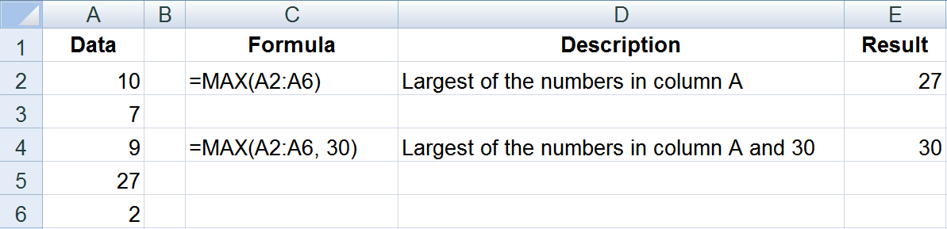
The MAX function

Slide 38
The MIN function
Syntax:
=MIN(number1,[number2],...)
Arguments:
number1, number2, ... Required
1 to 255 numbers for which you want to find the minimum value.

Slide 39
The MIN function
Description:
Returns the smallest value in a set of values.
Remarks:
Arguments can either be numbers or names, arrays, or references that contain numbers.
Logical values and text representations of numbers that you type directly into the list of arguments are counted.
If an argument is an array or reference, only numbers in that array or reference are used. Empty cells, logical values, or text in the array or reference are ignored.
If the arguments contain no numbers, MIN returns 0 (zero).
Errors:
Arguments that are error values or text that cannot be translated into numbers cause errors.

Slide 40
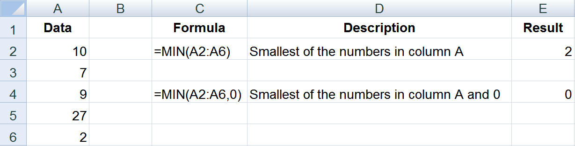
The MIN function

